Slide 1
Merge Sort

Slide 2
Merge Sort
One of the most popular sorting algorithms based on the principle of Divide and Conquer Algorithm.
In Divide and Conquer algrorithm:
a problem is divided into multiple sub-problems
Each sub-problem is solved individually.
Finally, sub-problems are combined to form the final solution.

Slide 3
Divide and Conquer Strategy
Suppose we had to sort an array A.
A subproblem would be to sort a sub-section of this array starting at index p and ending at index r, denoted as A[p..r].
Divide: If q is the half-way point between p and r, then we can split the subarray A[p..r] into two arrays A[p..q] and A[q+1, r].
Conquer: Try to sort both the subarrays A[p..q] and A[q+1, r]. If we haven't yet reached the base case, we again divide both these subarrays and try to sort them.
Combine: When the conquer step reaches the base step and we get two sorted subarrays A[p..q] and A[q+1, r] for array A[p..r], we combine the results by creating a sorted array A[p..r] from two sorted subarrays A[p..q] and A[q+1, r]
Merge Sort (With Code in Python/C++/Java/C) (programiz.com)

Slide 4
Merge Sort Algorithm
The MergeSort function repeatedly divides the array into two halves until we reach a stage where we try to perform MergeSort on a subarray of size 1 i.e. p == r.
After that, the merge function comes into play and combines the sorted arrays into larger arrays until the whole array is merged.
mergeSort(A, p, r):
if p >= r
return
q = (p+r)/2
mergeSort(A, p, q)
mergeSort(A, q+1, r)
merge(A, p, q, r)
Merge Sort (With Code in Python/C++/Java/C) (programiz.com)

Slide 5
Merge Sort Algorithm
Every recursive algorithm is dependent on a base case and the ability to combine the results from base cases.
The most important part of the merge sort algorithm is merge step.
The merge step is the solution to the simple problem of merging two sorted arrays to build one large sorted array.

Slide 6
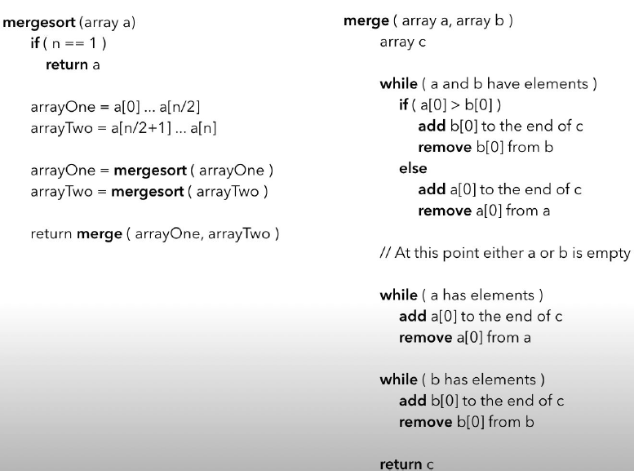
Merge Sort Algorithm

Slide 7
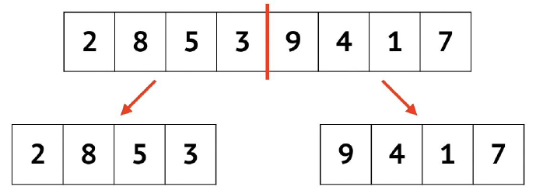
Merge Sort Example

Slide 8
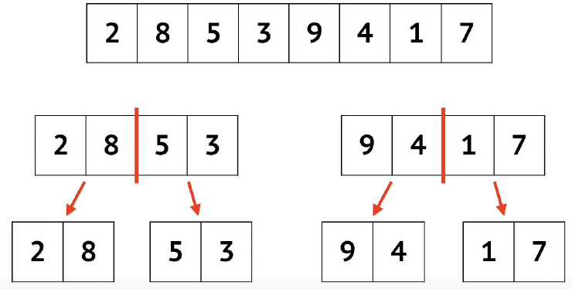
Merge Sort Example

Slide 9
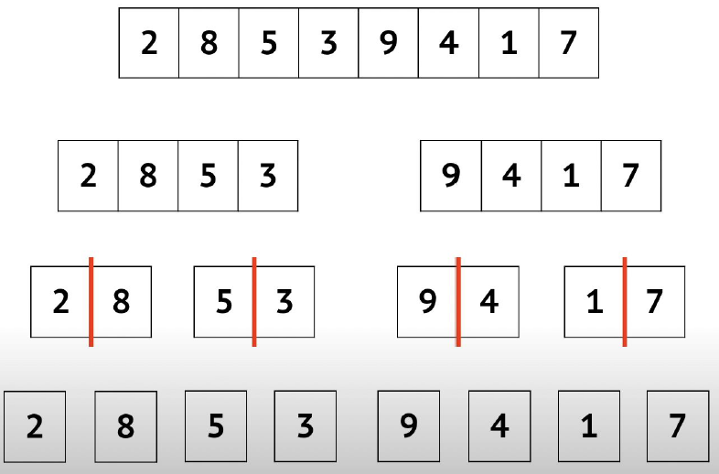
Merge Sort Example

Slide 10
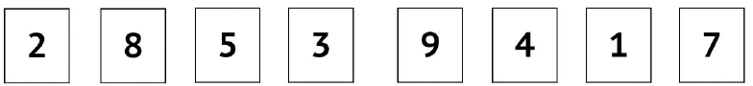
Merge Sort Example

Slide 11
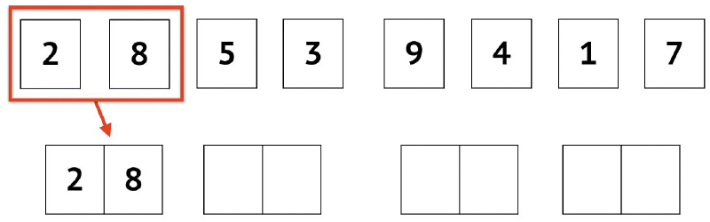
Merge Sort Example

Slide 12
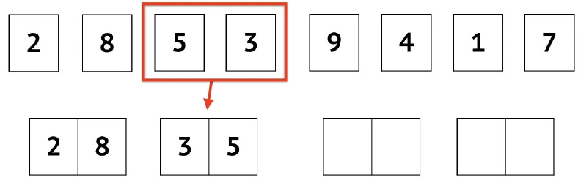
Merge Sort Example

Slide 13
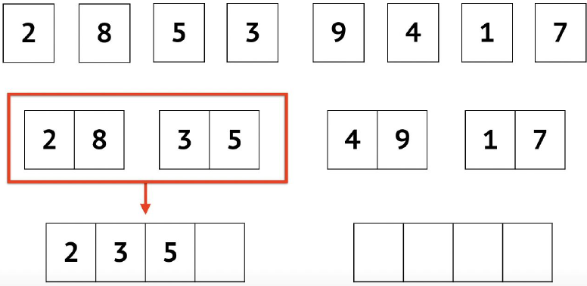
Merge Sort Example

Slide 14
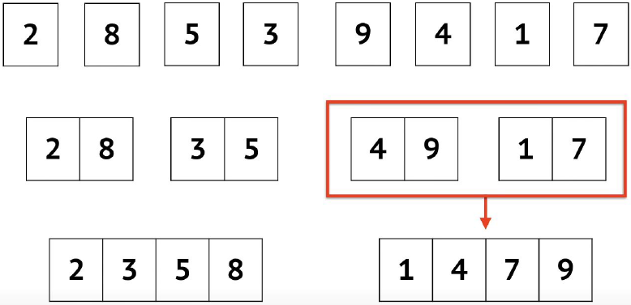
Merge Sort Example

Slide 15
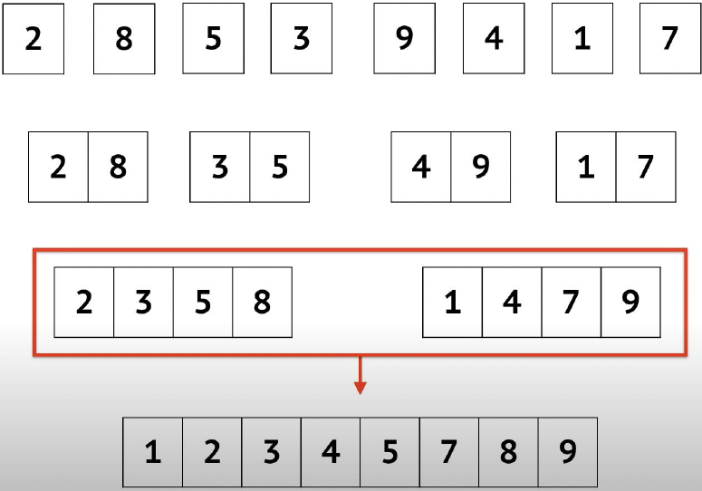
Merge Sort Example

Slide 16
Merge Sort Algorithm

Slide 17
Merge Sort Code: MergeSort Function
Code
Algorithm
mergeSort(A, p, r):
if p >= r
return
q = (p+r)/2
mergeSort(A, p, q)
mergeSort(A, q+1, r)
merge(A, p, q, r)
Source: Merge Sort (With Code in Python/C++/Java/C) (programiz.com)

Slide 18
Merge Sort Code: Merge Function
For merge function we need to do something like this in code→

Slide 19
Merge Sort Code: Merge Function
// Merge two subarrays L and M into arr
void merge(int arr[], int p, int q, int r) {
// Create L ← A[p..q] and M ← A[q+1..r]
int n1 = q - p + 1;
int n2 = r - q;
int L[n1], M[n2];
for (int i = 0; i < n1; i++)
L[i] = arr[p + i];
for (int j = 0; j < n2; j++)
M[j] = arr[q + 1 + j];
// Maintain current index of sub-arrays and main array
int i, j, k;
i = 0;
j = 0;
k = p;
// Until we reach either end of either L or M, pick larger among
// elements L and M and place them in the correct position at A[p..r]
while (i < n1 && j < n2) {
if (L[i] <= M[j]) {
arr[k] = L[i];
i++;
} else {
arr[k] = M[j];
j++;
}
k++;} // When we run out of elements in either L or M,
// pick up the remaining elements and put in A[p..r]
while (i < n1) {
arr[k] = L[i];
i++;
k++;
} while (j < n2) {
arr[k] = M[j];
j++;
k++;}}
Source: Merge Sort (With Code in Python/C++/Java/C) (programiz.com)

Slide 20
Merge Sort Time Complexity
Time Complexity
Best | O(n*log n)
Worst | O(n*log n)
Average | O(n*log n)
Space Complexity | O(n)
Stability | Yes
Source: Merge Sort (With Code in Python/C++/Java/C) (programiz.com)

